Slide 1
2.2: Introduction to linear models
Learning objectives
Understand terminology for mixed-effect models
Understand when random effects are appropriate
Understand basic computational approach to mixed-effect models

Slide 2
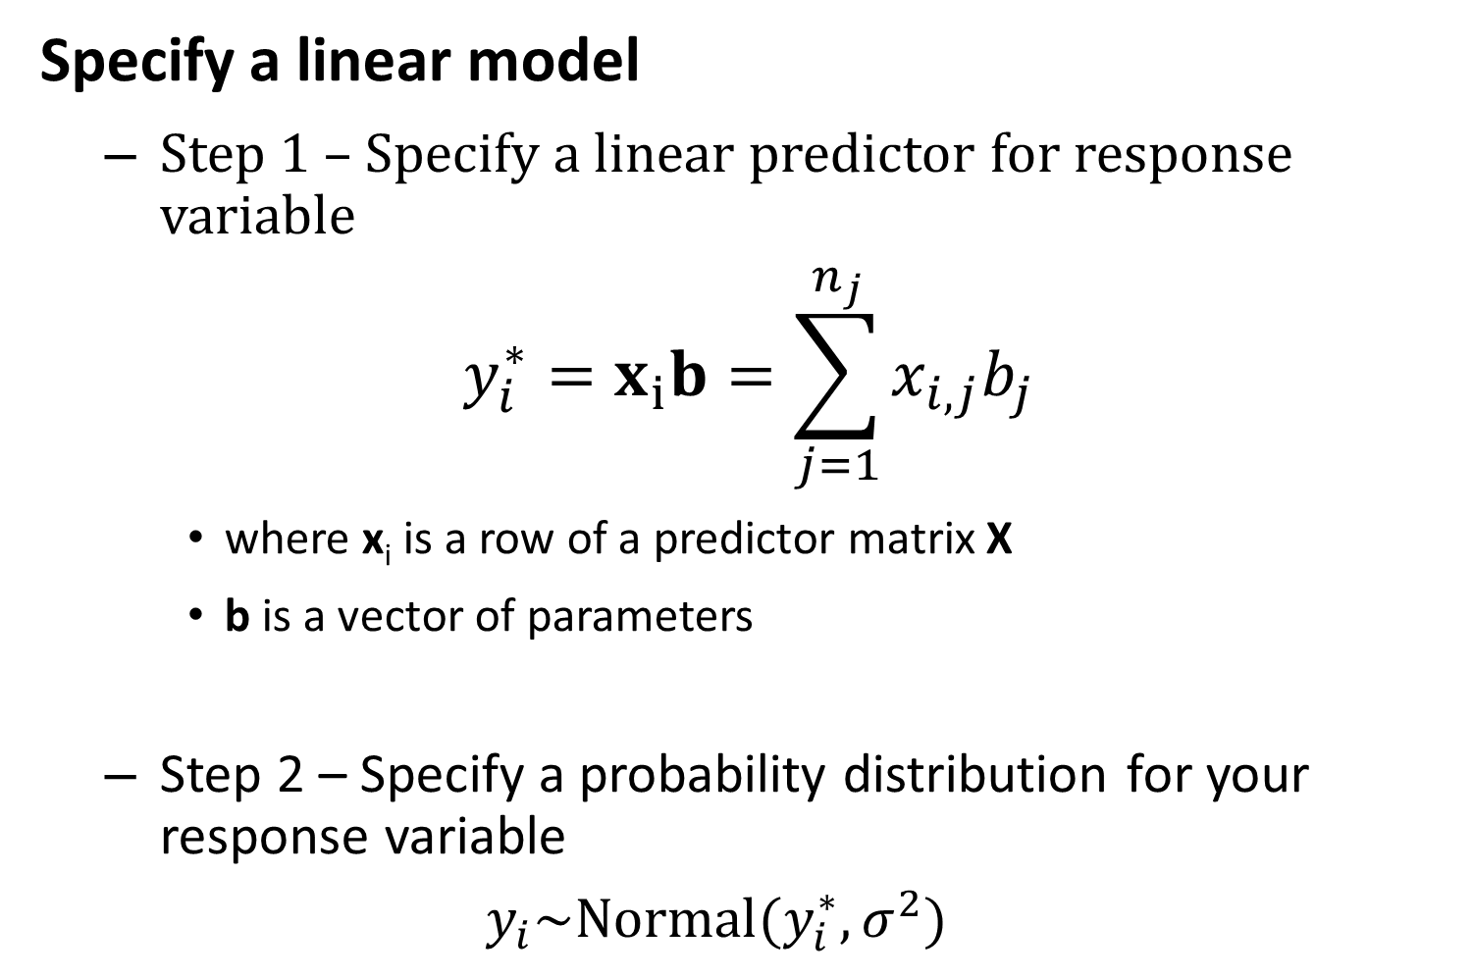
Specify a linear model
Step 1 – Specify a linear predictor for response variable
$$y_{i}^{∗}=x_{i}b=\sum_{j=1}^{n_{j}}{x_{i,j}b_{j}}$$
where x_{i} is a row of a predictor matrix X
b is a vector of parameters
Step 2 – Specify a probability distribution for your response variable
$$y_{i}\sim Normal(y_{i}^{∗},σ^{2})$$

Slide 3
Approach 1 – Use existing R functions
Step 1 – Find function
For linear model, use lm in the base package
Step 2 – Apply function
Usually easy in R
Step 3 – Extract information from object
Often hard
Sometimes use summary or attributes commands

Slide 4
Approach 1
[See R code]

Slide 5
Approach 2 – Build your own code
Step 1 – make function for log-likelihood
Step 2 – use nonlinear minimizer to find maximum likelihood estimate
Step 3 – estimate standard errors

Slide 6
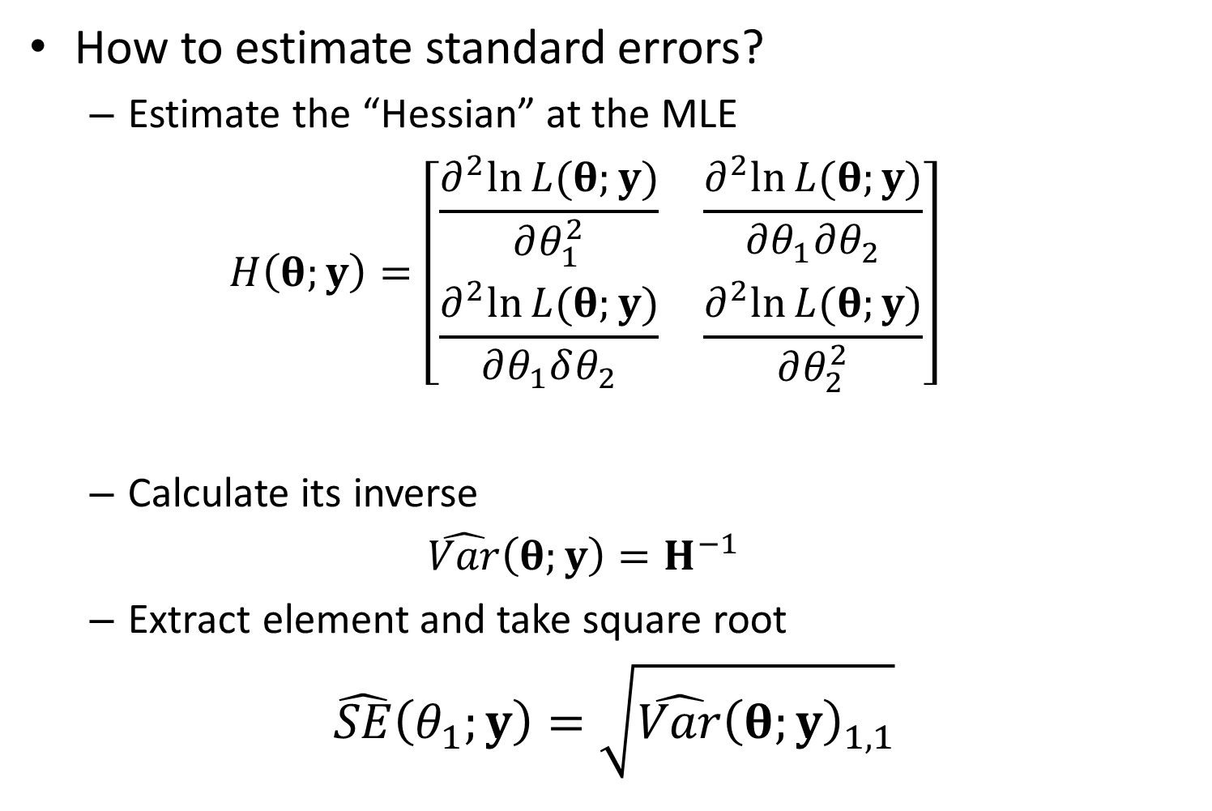
How to estimate standard errors?
Estimate the “Hessian” at the MLE
$$H\left(θ;y\right)=\left[\begin{matrix}\frac{∂^{2}ln⁡L(θ;y)}{∂θ_{1}^{2}} & \frac{∂^{2}ln⁡L(θ;y)}{∂θ_{1}∂θ_{2}} \\ \frac{∂^{2}ln⁡L(θ;y)}{∂θ_{1}δθ_{2}} & \frac{∂^{2}ln⁡L(θ;y)}{∂θ_{2}^{2}}\end{matrix}\right]$$
Calculate its inverse
$$\hat{Var}\left(θ;y\right)=H^{−1}$$
Extract element and take square root
$$\hat{SE}\left(θ_{1};y\right)=\sqrt{\hat{Var}{\left(θ;y\right)}_{1,1}}$$

Slide 7
Approach 2
[See R code]

Slide 8
Bayesian approach – Use JAGS
Step 1 – Define JAGS model
Uses specialized language, which can be tricky
Step 2 – Define starting values
This is optional
Step 3 – Run sampler
Uses MCMC algorithm to sample from posterior distribution for coefficients
Step 4 – Check model diagnostics

Slide 9
Bayesian approach
[See R code]

